Slide 1
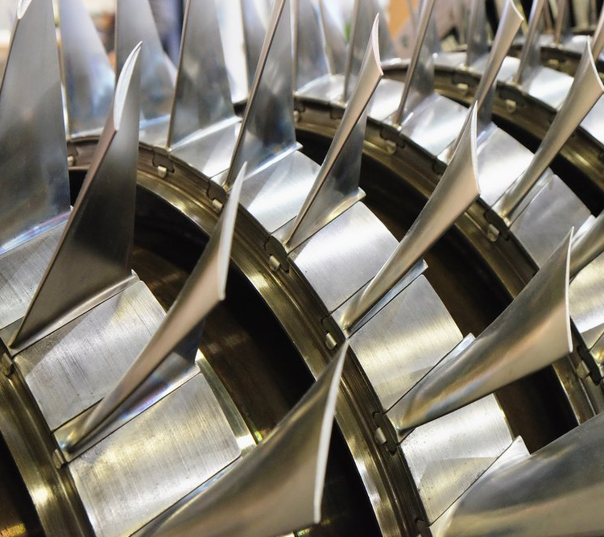
Soku IVD Sustain Close-Out/Post Implementation Review Session
To change the picture, delete the sample picture, then click the insert picture icon in the middle of the picture box.
Viya Fariku
Onshore Reliability Engineer
Theresa Abdulmalik
Onshore Reliability Engineer

Slide 2
AGENDA
 |  | Time
1 | HSSE and Agenda | 5 mins
2 | Welcome/Opening Remarks | 5 mins
3 | Introduction to IVD | 5 Mins
4 | Review of Objectives of Soku IVD Sustain | 5 Mins
5 | Review of Soku GP Compressor Trips (2022-2024) | 5 Mins
6 | Review of Soku GP Compressor Related Deferment (2022-2024) | 5 Mins
7 | Review of Soku GP Flare Volumes (2022-2024) | 5 Mins
8 | Highlights from IVD and Actions Moved to Fit4/MTO | 5 Mins
9 | Learnings and Challenges | 5 Mins
10 | Q&A | 10 Mins
11 | Closing Remarks | 5 Mins

Slide 3











Safety and Health
At Home
On site
Make sure your workspace is ergonomically sound
Know locations for fire alarms, extinguishers, emergency exits,
defibrillators, and muster points
Ensure adequate lighting in the room when you work
Make sure you can hear the fire alarm
Know what the fire alarm sounds like
Clean surfaces frequently
Maintain clear walkways and fire exits
On the move
Do not take this call, or any other call, while driving – ever
In the event of any kind of emergency, please leave the call – promptly and safely
Have an emergency and evacuation plan in place
Do not use any hands-free device – Bluetooth, built-in, etc. – whilst driving

Slide 4
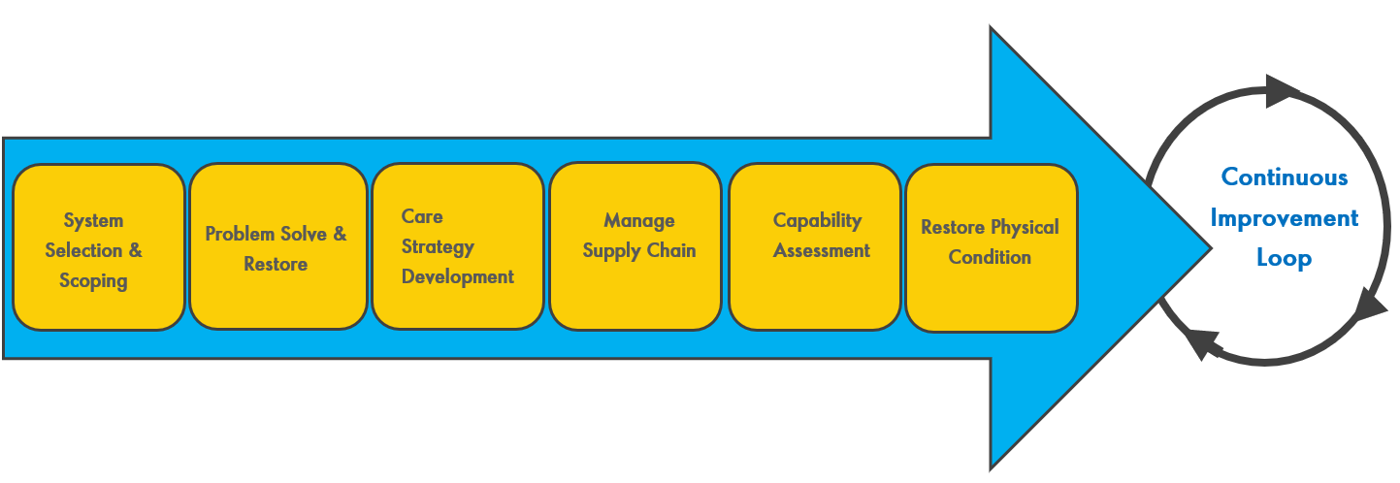
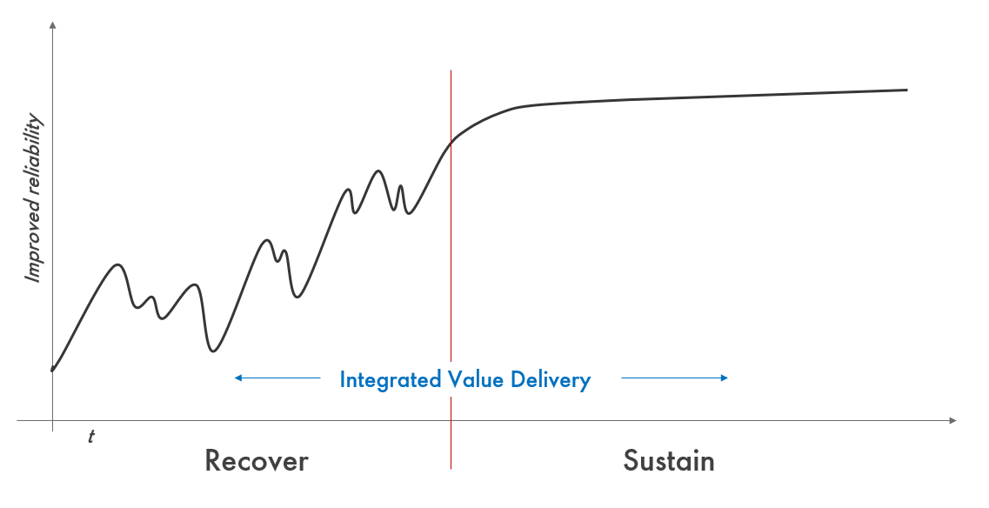
Integrated Value Delivery Process
What is IVD?
An E2E focused improvement on a system that is viewed as a reliability performance outlier, with potential to derive value improvement at speed.
Improvement scope kept manageable (months not years) leveraging Agile and Cadence.
Cross-functional integration with a reliability engineer at the center, and Asset LT sponsorship.
AMS MAC and MTO at its core, but fully integrated with other key AMS processes to maximize and sustain value.
Who is involved?
Frontline Leaders
Asset Operations & Maintenance engineers
Maintenance Execution and AGG Team
CMMS and the ORCSU
Reliability Engineers and EPST
Supply Chain and Logistics
Discipline Engineers and TAs
Capability Advisors
WRFM
Why do we do IVD?
Close performance gaps and G2P
Reduce unscheduled deferment
Reduce flaring
Sustained reliability and availability improvement
Deliver FCF gains
Copyright of SPDC

Slide 5
Review of Objectives of Soku IVD Sustain
The First IVD workshop in SPDC was done for Soku LP NAG and AG2 in 2019. A follow up IVD for the Soku Compressors to sustain performance was done in June 2022. The Objectives of the Soku IVD Sustain were:
Improve SPDC compressor reliability and reduce compressor related plant trips to:
Reduce Compressor Related deferment by 25%
Reduce flaring by 25%

Slide 6
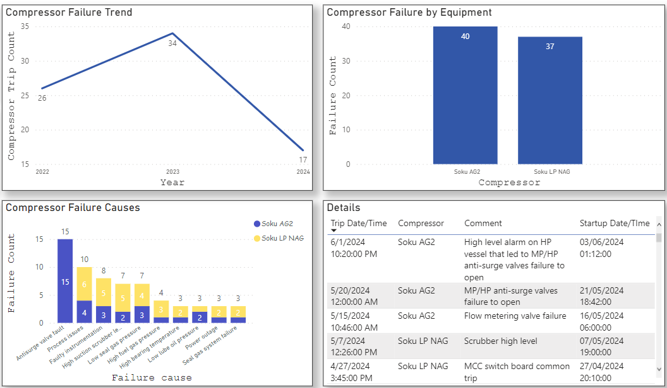
Review of Soku GP Compressor Trips (2022-2024)
Notes:
Compressor Trips went up from 26 in 2022 to 34 in 2023.

Slide 7
Review of Soku GP Compressor Related Deferment (2022-2024)
Notes:
Looking at this In light of the IVD goals,
The total deferment for oil went down by 22% from 2022 to 2023 and down 35% 2023 to 2024 YTD
The total deferment for gas went down by 51% from 2022 to 2023 and down 45% 2023 to 2024 YTD
In terms of Deferment per day for gas went down by 51% from 2022 to 2023 and down 10% 2023 to 2024 YTD

Slide 8
Review of Soku GP Flare Volumes (2022-2024)
Notes:
The total flare went down by 38% from 2022 to 2023 and down 37% 2023 to 2024 YTD
In terms of flare per day, it went down by 38% from 2022 to 2023 and down 8% 2023 to 2024 YTD

Slide 9
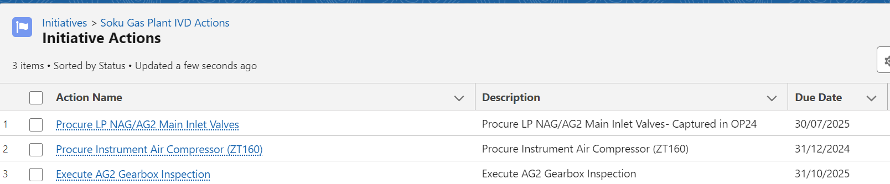
Highlights from IVD and Actions Moved to Fit4/MTO
Resolution of Radial Bearing Failure on AG2
Carried out overdue Bundle Change out AG2 – TAM Oct/Nov 2023
Carried out overdue Bundle Change out LPNAG
Mark VIe Training for Asset PACO personnel – July 2024
Soku Asset Care Plan

Slide 10
Learnings and Challenges
Weekly Cadence Approach provided visibility for actions.
Leadership focus had a positive effect on front line care & attention
Long Time to Implement IVD (June 2022- Date) delays Improvement and blurs Impact of IVD.
Longer Term Solutions may be abandoned when Short term operational actions give improvement.
Budget constraints leading to delay of executing agreed actions
Supply Chain bottlenecks
Improved Governance around Action Delivery and Clear Ownership will improve Process Efficiency
Causal Approach to handling Post IVD emerging threats would improve delivery and equipment uptime.

Slide 11
Q&A

